Slide 1
AUTOMATED DIRECTION Detecting BOT
B.TECH PROJECT
AAYUSH MISHRA 16095001
ASHWINI RAJ 16095013
KARTIKEY SINGH 16095029
KUSHAGRA SHARMA 16095033
Under the Supervision of Dr. V. N. Mishra

Slide 2
objective
To create an automated wireless bot that processes the image in front of it and traverses according to the direction detected.

Slide 3
introduction
The bot uses pi camera attached to raspberry pi for capturing images which are then classified using Tensorflow and according to the direction detected the L298n motor driver is given input which drives both the motors.
We have used two power sources of 5V and 9V to drive Raspberry Pi and L298n motor driver respectively.

Slide 4
Components USED
Raspberry Pi 3 model B
Raspberry Pi Camera Module V2 – 8 Megapixel,1080p
H-Bridge L298n Motor Driver Module
100 rpm, 12 Volts DC Motor
2 Amp, 5 Volts Source for Raspberry Pi
9V DC battery for L298n
Super Jumbo Bot Chassis
Plastic Bot Wheels
Castor Wheel

Slide 5
Technologies used
Python 2.7
Raspbian Operating System
Tensorflow
SSH(Secure Shell)
VNC(Virtual Network Computing)

Slide 6
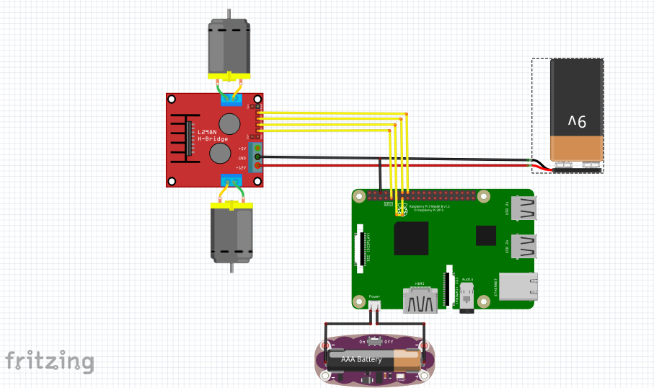
Circuitry

Slide 7
Pseudo code
Import dependencies
Capture image using pi camera
Save image path
Classify image
If direction==Up
Both motors move forward
Else if direction==Down
Both motors move backward

Slide 8
Else if direction==Left
Left Motor stationary, Right Motor forward
Else if direction==Right
Left Motor forward, Right Motor stationary
Repeat the above process till abort

Slide 9
Problems faced
Creating the dataset
Manually captured hundreds of pictures in different setups.
Installing correct dependencies
Raspberry OS uses a specific version of dependencies which are different than that on PC.
Hardware problems
Proper calibration of motor speed and making the bot wireless.
Model Selection and Training
Selecting suitable classifiers with minimum loss error.

Slide 10
applications
Automated vehicles to move in constrained environment like wildlife sanctuaries and recreational parks.
Helping people with disabilities to charter the course.

Slide 11
Future implementations
Increase the accuracy in the prediction of directions.
Reducing the time required for classification.
Increasing size of dataset.
Collision prevention using HC-SR04 ultrasonic sensors.
Voice control to provide override commands.
Send mass classification requests to server and redirection of multiple bots simultaneously .

Slide 12
Thank you

